Slide 1


SMART FASHION RECOMMENDATION SYSTEM USING RANDOM FOREST ALGORITHM
upGrad
Name | RegNo | Section
Arneet Kaur | 12014746 | K20UR
Shivangi Patel | 12001339 | K20UR
Theertha Sudheer Babu Nair | 12016472 | K20UR
COURSE : CSE 441 (INDUSTRY INTERNSHIP )
MENTOR : MR. SHAMNEESH SHARMA

Slide 2
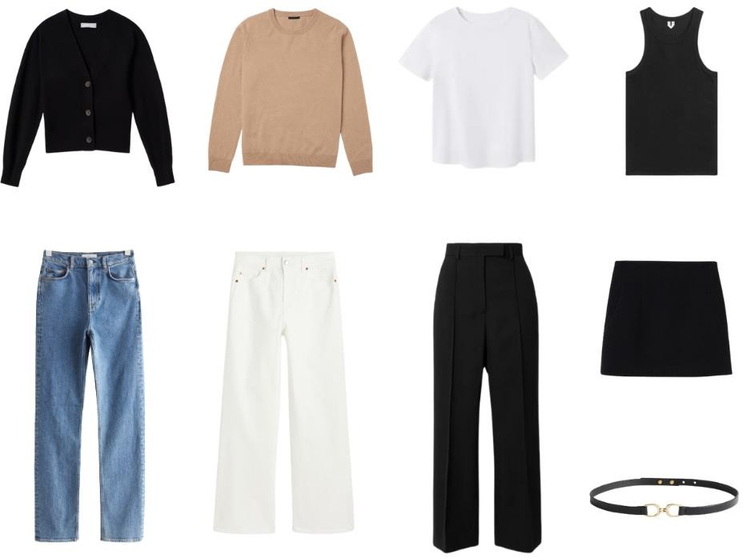
introduction
upGrad
The combination of technology and fashion has led to creative solutions targeted at personalizing the buying experience in today's rapidly evolving digital market. Therefore, researchers can fully use the potential of wearable technology in improving human well-being and quality of life by resolving difficulties and capitalizing on new opportunities.
From the various machine learning algorithms used to examine the data collected from smart garments, random Forest stands out as a best method. Random Forest algorithm in smart clothing systems, focusing on its effectiveness, challenges, and prospects This goes into detail on the Random Forest approach and its underlying concepts, such as ensemble learning and decision tree aggregation. Moreover, the benefits of Random Forest in smart clothing.

Slide 3
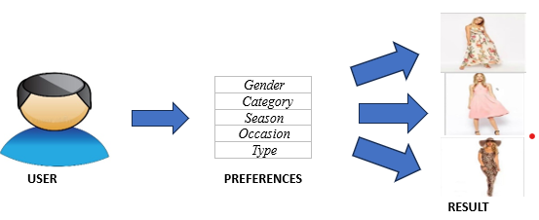
PROBLEM STATEMENT
upGrad
The main objective is to build an interactive user interface that makes use of machine learning techniques to deliver personalized garment recommendations based on user preferences, occasion, and body type compatibility with other protocols.
This covers researching various machine learning algorithms suitable for fashion recommendation systems, as well as developing methodology for acquiring and organizing user preference data. The project's fundamental goal is to design and implement an intuitive user interface that smoothly incorporates user inputs on preferences, situations, and body type.
.

Slide 4
Methodology
upGrad
Input User Preferences and Data
Data Preprocessing (e.g., Cleaning, Encoding)
Feature Extraction (Extracting Relevant Features )
Recommendation Generation from users
Output Personalized Fashion Recommendations
Model Selection(choosing appropriate ml model)
Final Model Evaluation (measure the performance of model)
Model Training (training the model)
Data collection produces a full dataset, whereas pre-processing assures data quality by removing missing values and duplicates. In feature Extraction the features are selected for the system through which we are able to recommend the fashion. The Recommendation Module uses Random Forest to evaluate data and make personalized recommendations based on user preferences. By identifying patterns, the technology optimizes the user experience by providing individualized fashion recommendations and increasing engagement and pleasure with the platform.
.

Slide 5

dataset description
upGrad
It's important to have a diverse dataset that includes different categories, brands, styles, colors, and patterns. Once data is there, label each one with attributes like category, color, pattern, and style. This will make it easier to analyze the data effectively
Therefore, our dataset comprises 11,584 rows and 13 columns, representing various attributes related to apparel items. Columns include 'id_no', 'Category', 'Sub-category', 'Type', 'Fit', 'Material', 'Pattern', 'Season', 'Style', 'Occasion', 'Body Type Suitability', 'Neckline', and 'Apparel'. These attributes encompass diverse characteristics such as garment type, fit, material composition, pattern, seasonal relevance, style, occasion suitability, body type suitability, neckline design, and the overall apparel category. This dataset serves as a comprehensive resource for analysing and understanding trends, preferences, and correlations within the fashion and apparel industry

Slide 6
Exploratory data analytics (eda)
upGrad
1. Data Collection: Gather a diverse dataset of fashion-related information,
including images, descriptions, and user preferences.
2. Data Cleaning: Remove any duplicate or irrelevant data, handle missing values, and standardize the
format of the data.
3. Data Visualization: Visualize the data to gain insights and identify patterns. You can create charts, histograms, or scatter plots to
understand the distribution of different fashion attributes.
3. Data Visualization: Visualize the data to gain insights and identify patterns. You can create charts, histograms, or scatter plots to
understand the distribution of different fashion attributes.
5. Feature Engineering: Extract relevant features from the data that can be used to build your recommendation system. This could include attributes
like color, style, brand, or user preferences.
4. Statistical Analysis: Perform statistical analysis on the data to
uncover trends, correlations, and other meaningful relationships.
6. Data Preprocessing: Prepare the data for modeling by encoding
categorical variables, normalizing numerical features, and splitting the dataset into training and testing sets.

Slide 7
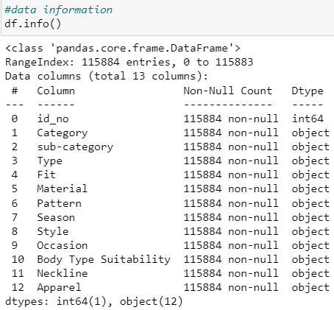
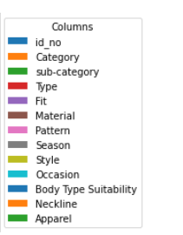
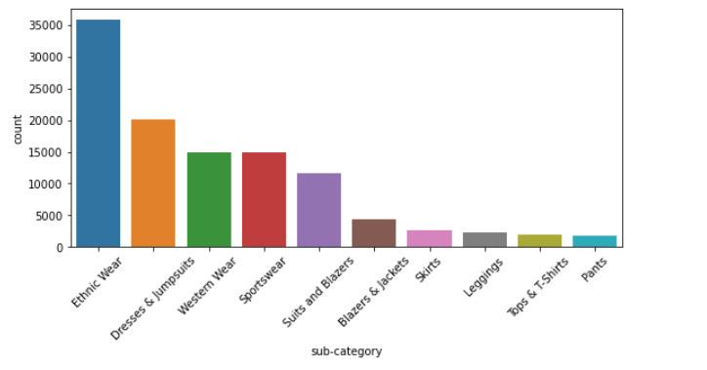
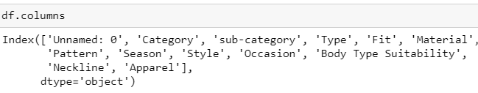
EDA PERFORMED
upGrad
.
Dataset offer a diverse range of clothing options, with a strong emphasis on ethnic wear, dresses, and western wear, catering to various style preferences and occasions

Slide 8
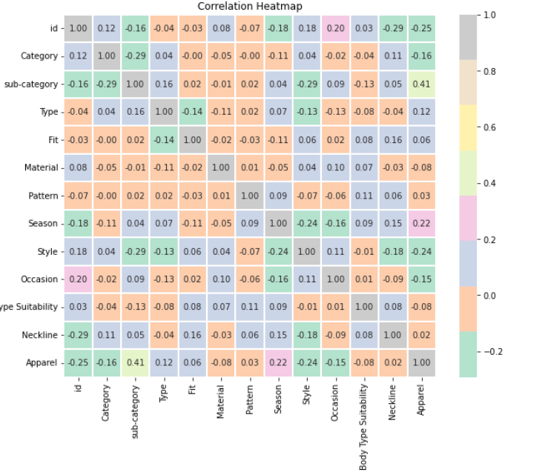
upGrad
A correlation matrix is a table showing correlation coefficients between variables. Each cell in the table represents the correlation between two variables. Correlation is a statistical measure that describes the strength and direction of a relationship between two variables.
correlation of +1 indicates a perfect positive correlation, meaning that as one variable increases, the other variable also increases. A correlation of -1 indicates a perfect negative correlation, meaning that as one variable increases, the other variable decreases. A correlation of 0 indicates no linear relationship between the variables.

Slide 9
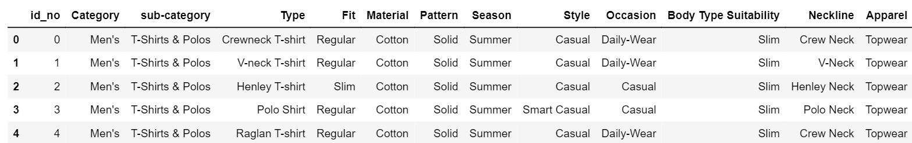
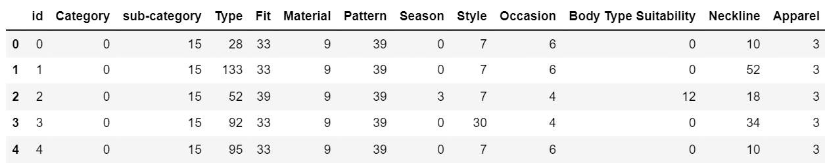
Feature engineering
upGrad
Feature engineering converts raw data into meaningful representations, such as user-item interaction matrices or feature vectors that include user demographics and item properties. Normalization techniques can be used to scale features correctly. Overall, rigorous data preprocessing improves Random Forest models' ability to generate accurate and tailored fashion recommendations.
Label encoding is a fundamental technique used in machine learning and data preprocessing, particularly in scenarios where categorical data needs to be converted into numerical form. In essence, label encoding assigns a unique numerical label to each category in a categorical feature, thereby enabling algorithms that only work with numerical data to process categorical information.

Slide 10
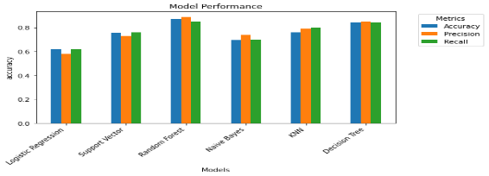
Model selection
upGrad
Random Forest
Random forest, a versatile machine learning algorithm, finds application in fashion recommendation systems due to its ability to handle large and complex datasets while providing accurate predictions. In the context of fashion recommendation, random forest can analyze various features such as clothing attributes and customer preferences to generate personalized recommendations. By constructing an ensemble of decision trees, random forest leverages the collective intelligence of multiple models to improve predictive accuracy and reduce overfitting. Each decision tree in the forest learns different aspects of the data, enabling the system to capture diverse patterns in fashion preferences.
Furthermore, random forest can handle both categorical and numerical data, making it suitable for incorporating a wide range of input variables relevant to fashion recommendation, including style, color, brand, and seasonality. Additionally, its inherent robustness to outliers and missing values enhances the robustness of the recommendation system. Through the integration of random forest in fashion recommendation systems, retailers and e-commerce platforms can offer customers tailored suggestions, thereby enhancing user experience, increasing engagement, and driving sales.
 | Algorithms | Accuracy
1. | Random forest | 84.6%
2. | Logistic regression | 61.8%
3. | KNN | 81.2%
4. | Support vector | 69.6%
5. | Naïve bayes | 73.5%
6. | Decision tree | 82.6%

Slide 11
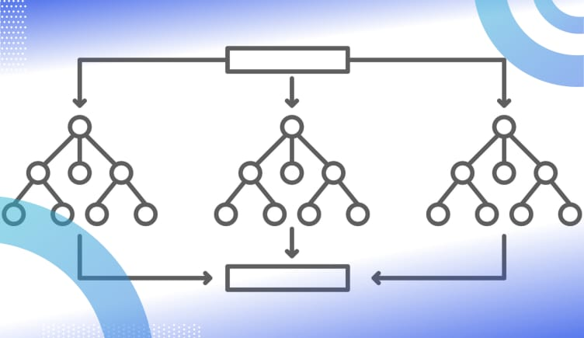
upGrad
MODEL TRAINING
In fashion recommendation systems, the Random Forest model is trained using pre-processed data to create an ensemble of decision trees that predict consumer preferences for clothing items. The program discovers patterns and correlations between user data (including demographics and style preferences) and item characteristics (such as fabric , pattern and fit). The Random Forest model generates robust recommendations by iteratively separating data based on feature relevance. Random Forest's capacity to manage complicated interactions and nonlinear correlations makes it excellent at generating personalized fashion recommendations based on specific user preference.
data
gender
type
ocassion
output

Slide 12
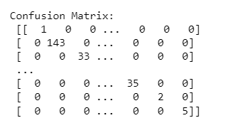
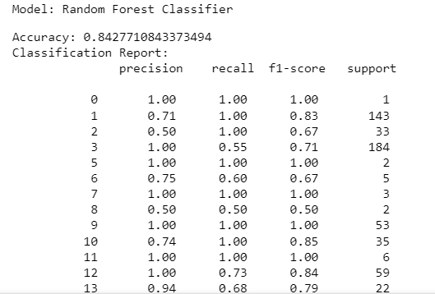
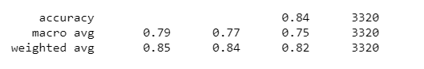
Model evaluation
upGrad
These metrics provide different perspectives on the performance of the model. While accuracy gives an overall idea of how well the model is performing, precision and recall are especially useful when the cost of false positives and false negatives are significantly different.
A confusion matrix is a table that is often used to describe the performance of a classification model on a set of test data for which the true values are known. It's a matrix with rows representing the actual classes and columns representing the predicted classes.

Slide 13
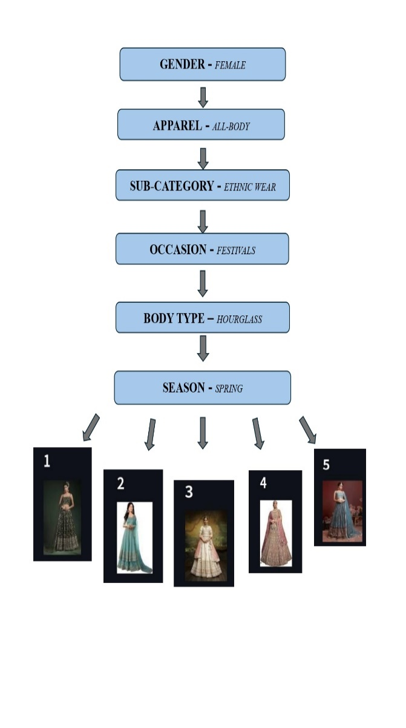
Result And analysis
upGrad
Input from user
Based on the user input data provided
Gender: Female
Apparel: All-Body
Sub-category: Ethnic Wear
Occasion: Festivals
Body Type: Hourglass
Given the user's taste for Ethnic Wear, reasonable recommendations would include apparel products classed as Ethnic Wear that are ideal for festivals and the Spring season.
These suggestions could include classic ethnic costumes, sarees, salwar suits, lehengas, or fusion outfits made for special events. Furthermore, the system would take into account the user's body type (Hourglass) when recommending styles and fits that compliment and improve their shape.
The recommendations offered to the user would emphasize fashion goods that match their likes and wants, resulting in a personalized and relevant purchasing experience tailored to their individual style and requirements.

Slide 14
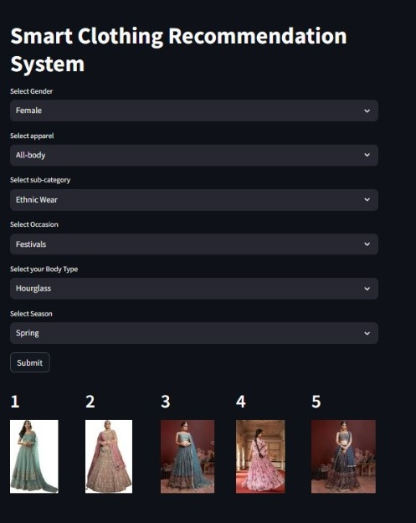
deployment
upGrad
The deployment of Random Forest-based smart fashion recommendation system on stream lit is seamlessly integrated strong machine learning algorithms with an easy user experience. Utilized Stream lit, a Python framework for creating interactive web apps for machine learning and data science projects, to convert machine learning model into a web application that could be accessed by a wider audience. Also included other libraries needed for the model interpretation and data preprocessing. Once the configuration was complete, use Render's user-friendly web interface to deploy Stream lit app. The requirements mentioned in requirements.txt were automatically detected by render and set up the required runtime environment with Python and the required dependencies.. After that, we released our Stream lit app to a cloud infrastructure that could grow with us, enabling users all over the world to use it. In conclusion, people can now easily and conveniently interact with our machine learning model by downloading it as a stream lit app on Render.

Slide 15
Challenges and limitations
upGrad
User Input Scope: During the suggestion process, the system will only use explicit user input. It won't consider implicit user signals from social encounters, past surfing activity, or purchasing patterns. When compared to systems that employ both explicit and implicit user input, this delimitation may make recommendations that are less accurate and limit the system's capacity to fully understand the user's preferences.
Restricted Feature Set: To produce recommendations, the system will rely on a predetermined set of user input features, such as favored colors, styles, and apparel categories. It won't flexibly change or add features in response to user input or interactions. This boundary could limit the system's capacity to identify subtle nuances in user preferences and lead to recommendations that are less tailored to the individual.
Scalability Issues: When working with huge databases of clothing items and customer preferences, the system may run into scalability issues. As dataset sizes grow, Random Forest models may become more computationally costly to train and assess. The system's capacity to manage a high amount of user requests may be limited by this delimitation, necessitating optimization strategies to enhance efficiency.
Static Model Training: A fixed dataset of clothing products and user preferences will be utilized to train the Random Forest model, which powers the recommendation engine, offline. Retraining or updating the model in response to feedback or real-time user interactions is not planned. This boundary could cause the model to become stagnant and unable to change over time to accommodate shifting user preferences or fashion trends.

Slide 16
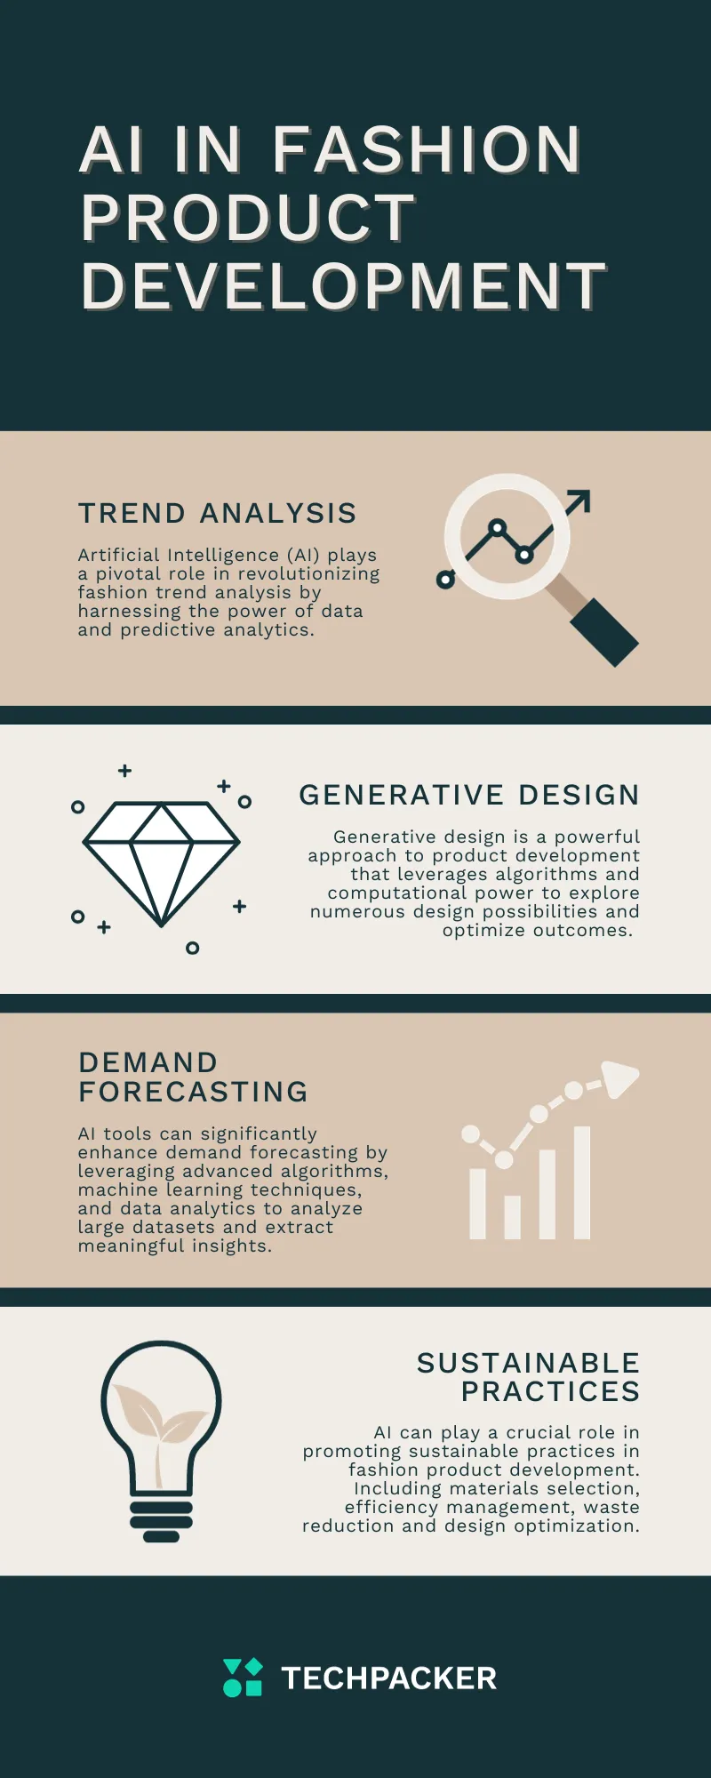
Future work
upGrad
The future of random forest-based fashion recommendation systems looks promising. One technique is to mix cutting-edge features such image embeddings generated by deep learning models trained on fashion images. Using these intricate visual representations, recommendations can become more subtle and visually appealing. Furthermore, hybrid models that integrate Random Forests with other techniques, such as deep learning or reinforcement learning, demonstrate promise. Such combinations could benefit from Random Forests' interpretability while also accessing the intricate patterns and context inherent in more complex models.

Slide 17
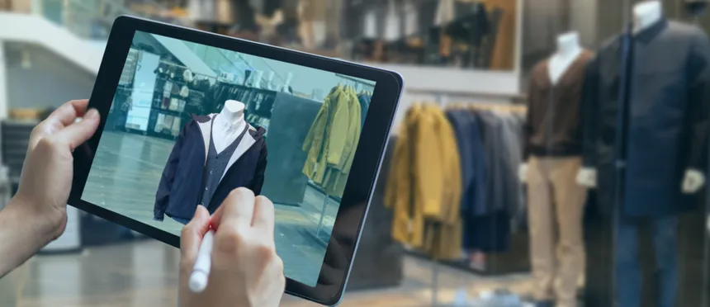
conclusion
upGrad
In conclusion, a smart fashion recommender model is built after trying out different machine learning algorithms. Random Forest Algorithm plays a crucial role in this recommendation system by providing the finest potential clothing to those seeking fashion suggestions in accordance with their sense of style with an accuracy of nearly 84.28% However, this accuracy keeps changing as we are training a huge dataset and takes time to provide the desired result. The Random Forest Classifier performs pretty well overall; but further study and even model adjustment could enhance its accuracy, particularly in classes with lower performance metrics. While it excelled in a few of categories with great precision and recall, it sometimes performed poorly in others. However, the system does an outstanding job in creating a fashion sense in its users and is able to provide the best recommendations based on the user's clothing.
.

Slide 18
references
upGrad
1.Sharma, S.; Koehl, L.; Bruniaux, P.; Zeng, X.; Wang, Z. Development of an Intelligent Data-Driven System to Recommend Personalized Fashion Design Solutions. Sensors 2021, 21, 4239. https://doi.org/10.3390/s21124239
2. S. Sharma, L. Koehl, P. Bruniaux and X. Zeng, "Garment Fashion Recommendation System for Customized Garment," 2019 International Conference on Industrial Engineering and Systems Management (IESM), Shanghai, China, 2019, pp. 1-6, doi: 10.1109/IESM45758.2019.8948164.
3. Yoon Ho Cho, Jae Kyeong Kim, Soung Hie Kim, “A personalized recommender system based on web usage mining and decision tree induction”, Expert Systems with Applications, Volume 23, Issue 3,2002, Pages 329-342, ISSN 0957-4174, https://doi.org/10.1016/S0957-4174(02)00052-0
4. X. Chen, H. Chen, H. Xu, Y. Zhang, Y. Cao, Z. Qin, and H. Zha, “Personalized fashion recommendation with visual explanations based on multimodal attention network: Towards visually explainable recommendation,” in Proceedings of the 42Nd International ACM SIGIR Conference on Research and Development in Information Retrieval, ser. SIGIR’19. New York, NY, USA: ACM, 2019, pp.765–774. [Online]. Available: http://doi.acm.org/10.1145/3331184.3331254
5. H. M. Gomes, A. Bifet, J. Read, J. P. Barddal, F. Enembreck, B. Pfharinger, G. Holmes, and T. Abdessalem, “Adaptive random forests for evolving data stream classification,” vol. 106, no. 9, pp. 1469–1495. [Online]. Available: https://doi.org/10.1007/s10994-017-5642-8
6. M. D. Buhmann et al., ‘Recommender Systems’, in Encyclopedia of Machine Learning, C. Sammut and G. I. Webb, Eds. Boston, MA: Springer US, 2011, pp. 829–838.
7. Kang, W., Fang, C., Wang, Z., McAuley, J.: Visually aware fashion recommendation and design with generative image models. In: 2017 IEEE International Conference on Data Mining (ICDM), pp. 207–216 (2017). https://doi.org/10.1109/ICDM.2017.30

Slide 19
thank you
upGrad

